Slide 1

Introduction to Operating Systems CS/COE 1550
Spring 2022
Sherif Khattab
ksm73@pitt.edu
(Some slides are from Silberschatz, Galvin and Gagne ©2013)

Slide 2
Announcements
Lab 0 due this Friday (soft deadline; not graded)
Homework 1 will be posted this Friday
Recitations start this week
VS Code setup tutorial on Piazza (also linked from Canvas)
Draft Slides linked from Canvas

Slide 3
Agenda
Main tasks of an operating system
System Calls
What an interrupt is
What happens when an interrupt occurs
What a system call is
How system calls implemented
Effect of OS structure on system calls

Slide 4
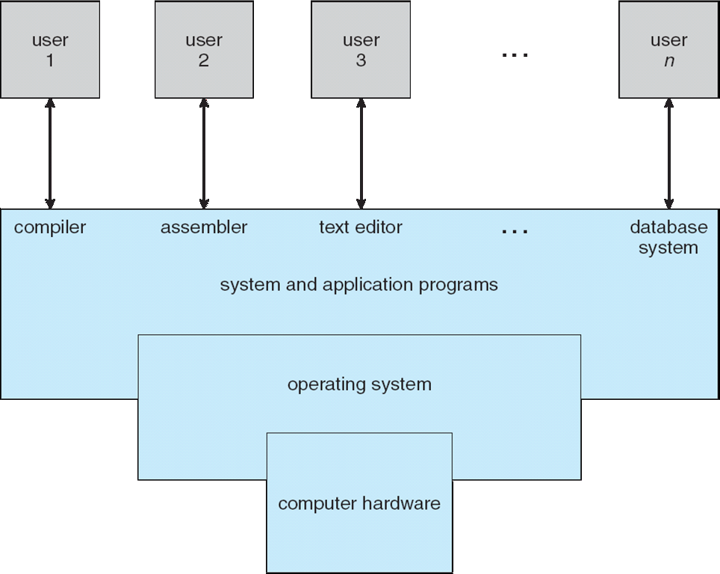
What is an Operating System?
A program that acts as an intermediary between a user of a computer and the computer hardware

Slide 5
What does an OS do?
Manages (controls and arbitrates) resources
Processors, Memory, Input/output devices, Communication devices, Storage, Software applications
Conflicting goals:
e.g., performance vs. utilization
Separation of policy and mechansim
Provides abstractions to application programs
Ease of use
Virtualization
Protects resources

Slide 6
Interrupts
Hardware or software:
Hardware interrupt by one of the devices
Software interrupt (exception or trap):
Software error (e.g., division by zero)
Other process problems include processes trying to modify each other’s or the operating system’s memory (e.g., segmentation fault)
Request for operating system service (i.e., system call)

Slide 7
Interrupt Descriptor Table
Interrupt transfers control to the interrupt service routine (ISR)
ISRs are segments of code that determine what action should be taken for each type of interrupt
part of the OS kernel
An interrupt vector contains the address of the ISR for one interrupt
An interrupt vector table is an array of interrupt vectors
also known as interrupt descriptor table (IDT)

Slide 8
Dual-mode Operation
Dual-mode operation allows OS to protect itself and other system components
At least two modes: user mode and kernel mode
Mode bit(s) provided by hardware (inside CPU registers)
Provides ability to distinguish when system is running user code or kernel code
Some instructions designated as privileged, only executable in kernel mode
Some memory addresses designated as privileged, only accessible in kernel mode
Therefore, we get segmentation fault on null (i.e., 0) pointer dereference
Interrupts change mode to kernel
return from interrupt resets mode back to user
Increasingly CPUs support multi-mode operations
virtual machine manager (VMM) mode for guest VMs

Slide 9
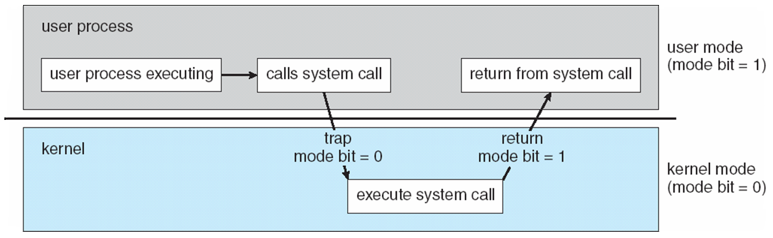
What happens when an interrupt occurs?
The CPU transitions from User Mode to Kernel Mode
an interrupt
occurs
return from ISR
execute ISR
Time

Slide 10
How does an OS (roughly) work?

Slide 11
What happens on a hardware interrupt?
6
1
4
7
5
9
2
3
8

Slide 12
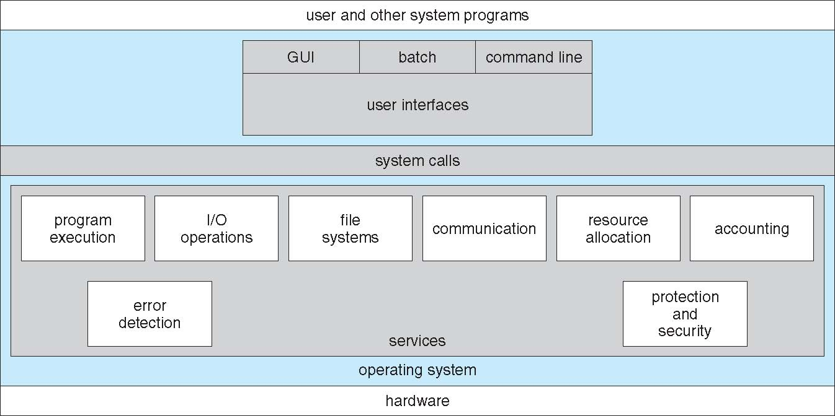
System Calls

Slide 13
System Calls
Programming interface to OS services
Typically written in a high-level language (C or C++)
Mostly accessed by programs via a high-level Application Programming Interface (API) rather than direct system call use
Win32 API for Windows
POSIX API for POSIX-based systems (including virtually all versions of UNIX, Linux, and Mac OS X), and
Java API for the Java virtual machine (JVM)

Slide 14
System Call Implementation
Typically, there is a number associated with each system call
Each system call has a corresponding system call implementation function (part of the OS kernel)
System-call table indexed according to these numbers
Each entry in the table contains the address of the corresponding system call implementation function
The system call interface is the ISR corresponding to the syscall software interrupt
invokes the intended system call in OS kernel,
passes arguments if needed, and
returns status of the system call and any return values
The caller need know nothing about how the system call is implemented

Slide 15
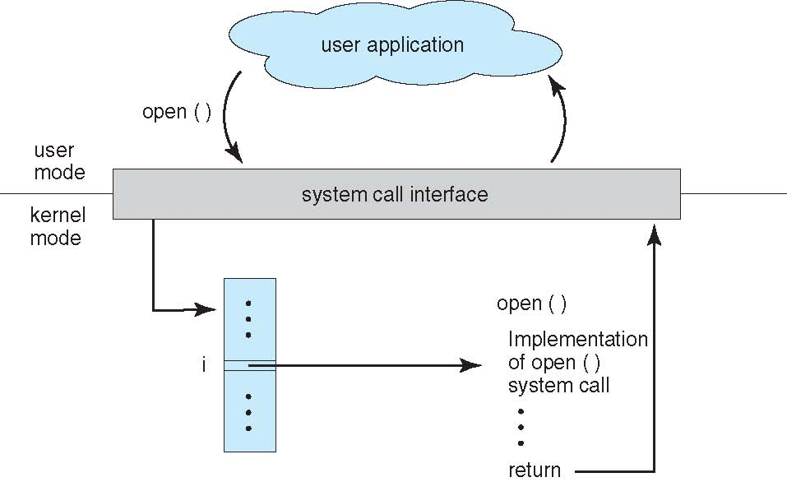
API – System Call – OS Relationship

Slide 16
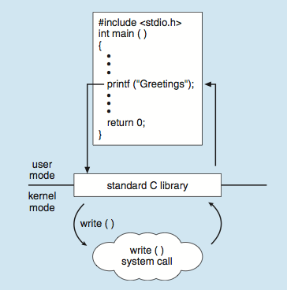
Standard C Library Example
C program invoking printf() library call, which calls write() system call

Slide 17
What happens on a syscall?
2
1
7
6
12
1
eax <-- 1
10
3
int 64
5
4
11
8
9

Slide 18
System Call Parameter Passing
Three general methods used to pass parameters to the OS
Simplest: pass the parameters in registers
In some cases, may be more parameters than registers
Parameters stored in a block, or table, in memory, and address of block passed as a parameter in a register
This approach taken by Linux and Solaris
Parameters placed, or pushed, onto the stack by the program and popped off the stack by the operating system
XV6
Block and stack methods do not limit the number or length of parameters being passed

Slide 19
How to add a system call to an OS?

Slide 20
Xv6 Code Walkthrough
IDT table initialization
Syscall table
How a syscall is invoked
Syscall implementation
Parameter passing into a syscall
In Lab 1 you will add a system call to Xv6

Slide 21
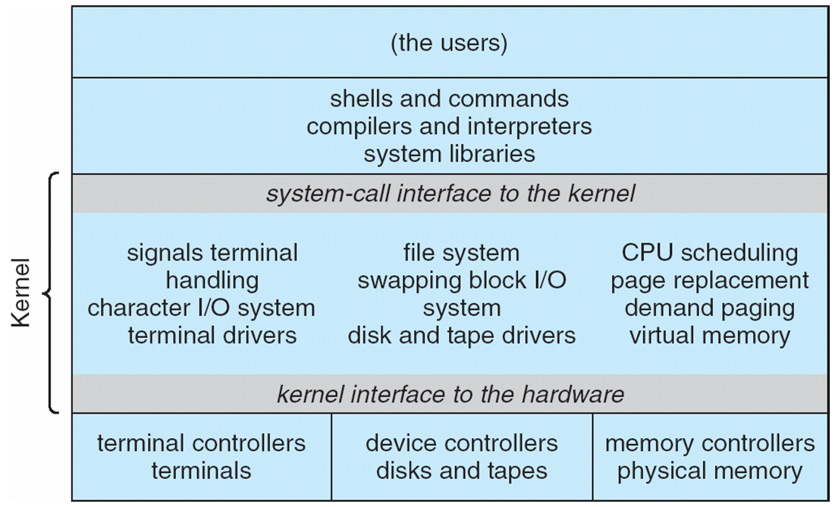
Traditional UNIX System Structure
Beyond simple but not fully layered

Slide 22
Microkernel System Structure

